Slide 1
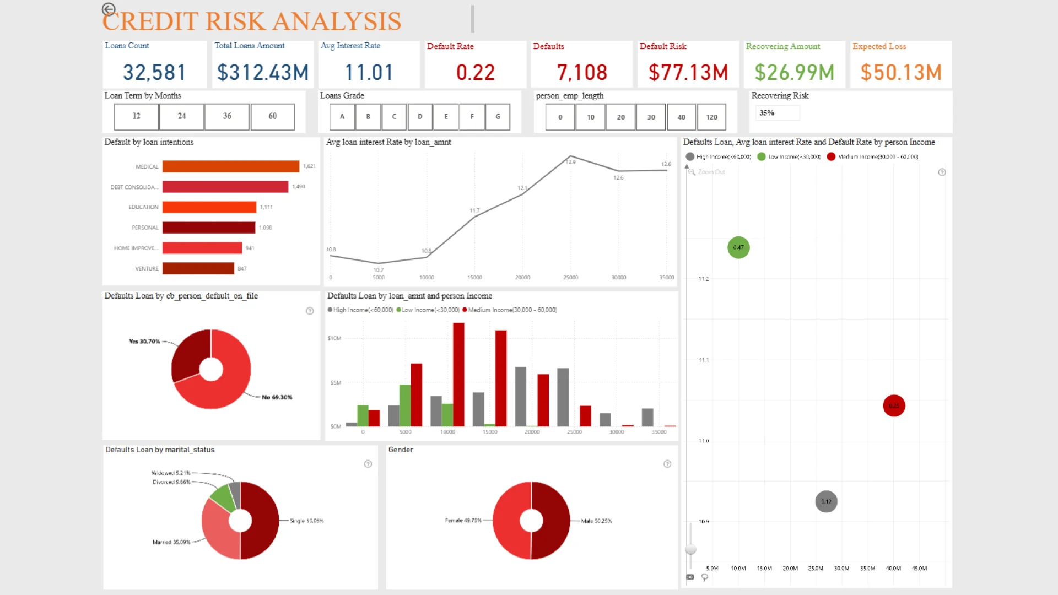
Data Bootcamp
Credit Risk
Exploratory Data
Analysis
Group 12
February 2026
Skye Xi
Jonathan Cain Sab Rajesh Krishnan
Risk Assessment
Data-Driven Insights

Slide 2
02 • Key Variables
Risk Assessment Framework
T
TARGET
Risk Factor Hierarchy
Primary Outcome Variable
0
1
Structural Stability
High Impact
On-time Payments
Payment Difficulties
Employment tenure, education level, age
Variable Categories
Financial Magnitudes
Medium Impact
Employment
Demographics
Credit amount, goods price, income
DAYS_EMPLOYED, AMT_INCOME_TOTAL
YEARS_BIRTH_CATEGORY, CODE_GENDER
Interaction Effects
High Impact
Socioeconomic
Family Status
NAME_EDUCATION_TYPE, NAME_INCOME_TYPE
Loan-to-income, tenure-income relationships
NAME_FAMILY_STATUS
Financial
Historical
Key Insight
AMT_CREDIT, AMT_GOODS_PRICE
NAME_CLIENT_TYPE, NAME_CONTRACT_STATUS
Stability indicators provide stronger risk separation than raw financial values alone.

Slide 3
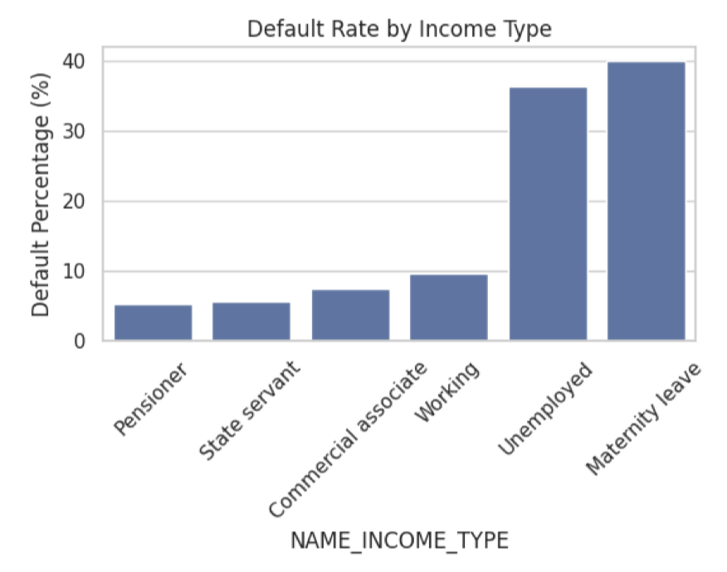
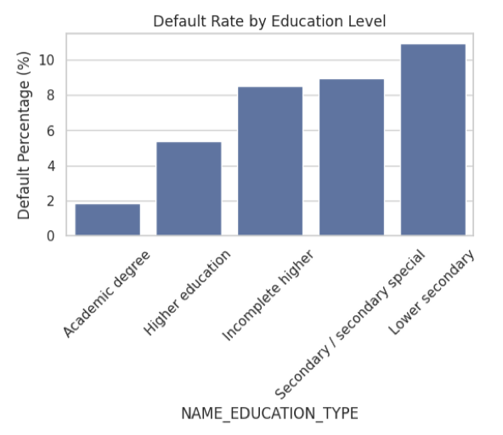
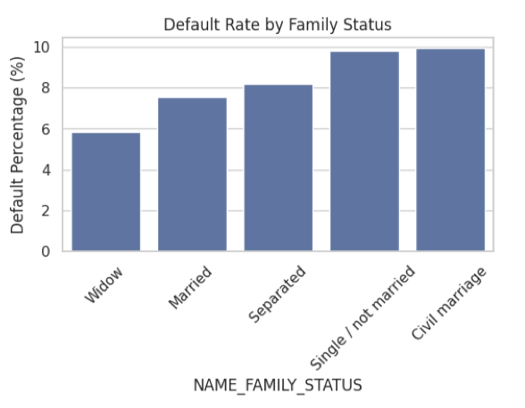
03 • Univariate Analysis
Categorical Variables
Income Type
Education Level
Family Status
Income Type: Stable income groups (pensioners, state servants) show the lowest default risk (~5–6%), while unemployed or maternity-leave borrowers exhibit the highest (~36–40%), though these estimates are less reliable due to small samples. Core workforce segments fall in the moderate range (~7–10%).
Education Level: A clear inverse relationship exists between education and default risk. Borrowers with academic degrees have the lowest default rates (~2%), increasing steadily as education decreases, peaking near ~11% for the lowest education category. Education is therefore a strong risk proxy.
Family Status: Differences are present but less pronounced. Widowed borrowers have the lowest defaults (~6%), while single or civil-marriage borrowers approach ~10%, suggesting household stability modestly affects risk.
Key Finding: Borrowers with stronger financial and structural stability—reflected in stable income sources, higher education levels, and more stable household structures—demonstrate significantly lower loan default risk, making these factors the most powerful predictors of repayment performance.

Slide 4
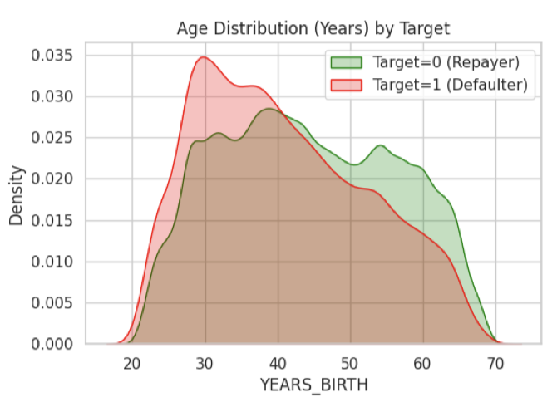
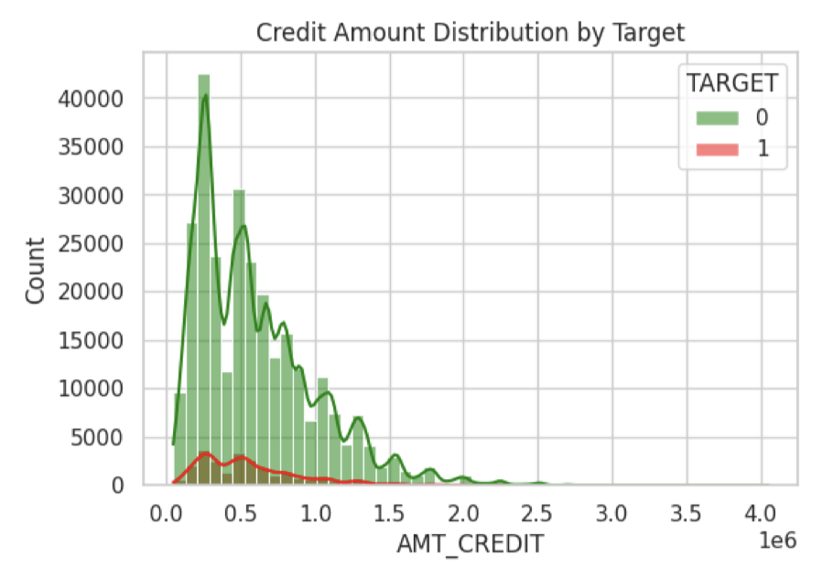
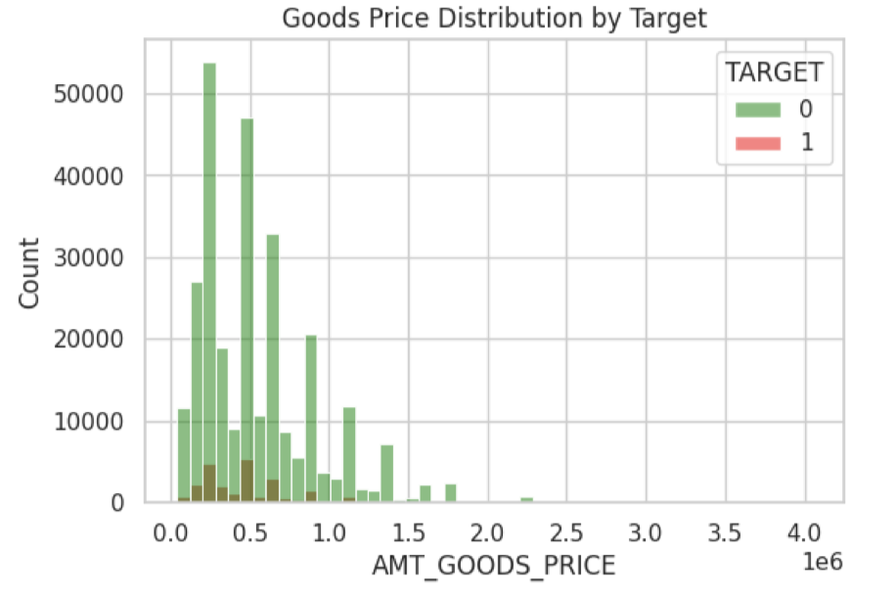
04 • Univariate Analysis
Numerical Variables
Age Distribution by Repayment Status
Credit Amount Distribution
Goods Price Distribution
Loan & Goods Amounts:
Both variables are heavily right-skewed and show similar distributions across defaulters and non-defaulters, suggesting that absolute loan size alone is not a strong discriminator of risk; relative metrics (e.g., loan-to-income ratios) are likely more predictive.
Key Insight: Defaulters (TARGET=1) concentrated in 25-35 age range , while repayers show broader middle-age distribution. Younger applicants are overrepresented among defaulters.
Critical Finding: Age is a strong risk-associated factor, while raw financial magnitudes show limited discriminatory power. Loan-to-income relationships may be more predictive than absolute amounts.

Slide 5
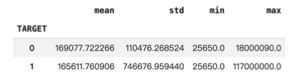
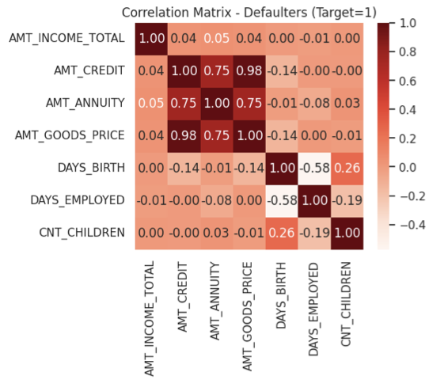
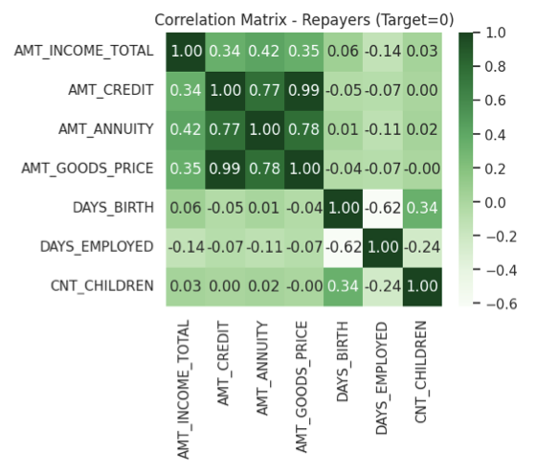
05 • Bivariate Analysis
Correlation Structure
Defaulters (TARGET=1)
Repayers (TARGET=0)
Variance & Heterogeneity:
Both groups have similar income means and ranges, but defaulters exhibit substantially higher variance. This implies greater income instability or heterogeneity among defaulters rather than differences driven by income level alone.
Repayers Pattern
Income ↔ Credit:
0.34
Key Insight
Income ↔ Annuity:
0.42
Income-aligned loan sizing observed
Income–Loan Alignment:
Among on-time payers, income is moderately correlated with credit amount (0.34) and annuity (0.42), indicating loan sizing is aligned with repayment capacity. In contrast, correlations for defaulters are near zero (0.04–0.05), suggesting weak income-based underwriting within this group.
Default risk is driven less by absolute income level and more by how well loan obligations are calibrated to a borrower’s repayment capacity. The sharp divergence in correlation patterns indicates that defaulters often received loans misaligned with their income, pointing to underwriting decisions that insufficiently accounted for repayment ability.
Defaulters Pattern
Income ↔ Credit:
0.04
Income ↔ Annuity:
0.05
Weak income association

Slide 6
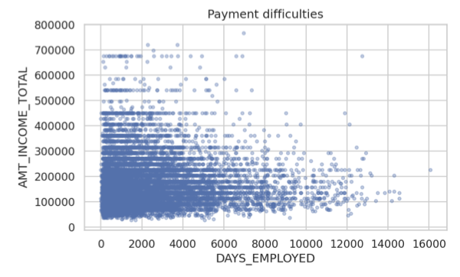
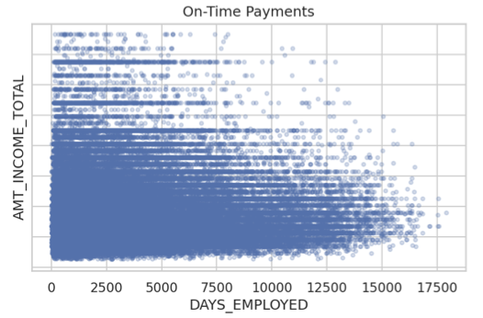
06 • Bivariate Analysis
Numeric Variable Relationships: Employment Duration vs. Income Analysis
Employment Duration vs. Total Income by Repayment Status
Employment Tenure
Long employment histories are more prevalent among on-time payers, indicating job stability as a key predictor.
Median Tenure:
Repayers: ~8.5 years
Defaulters: ~4.2 years
Income Overlap
Income ranges overlap strongly between repayment groups, suggesting income alone is insufficient for risk assessment.
Income Variance:
Defaulters show higher variance, indicating greater heterogeneity.
Key Conclusion
Tenure appears to be a more informative stability proxy than income alone.

Slide 7
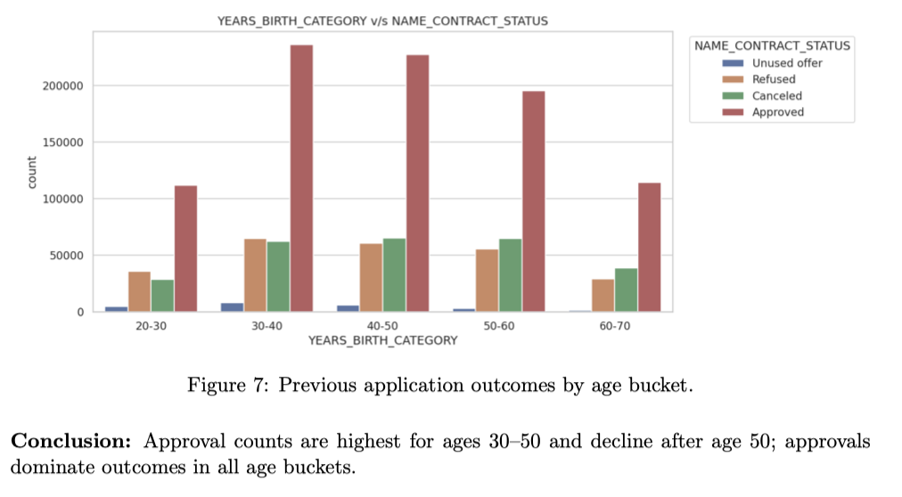
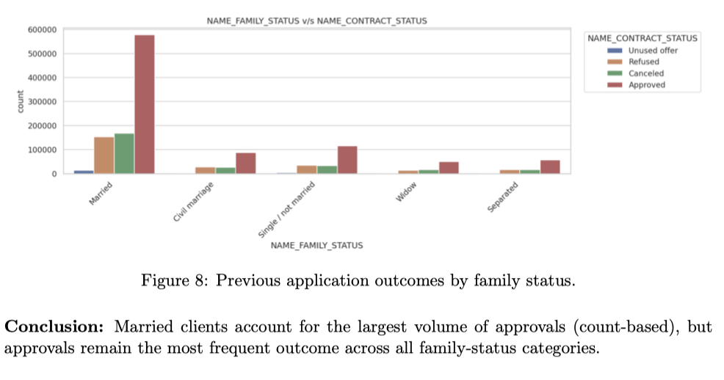
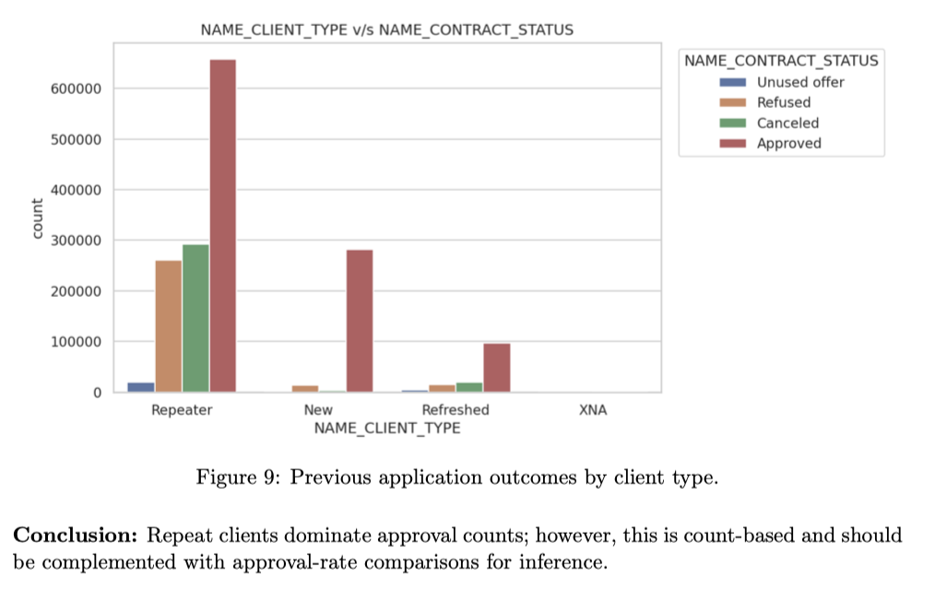
06 • Bivariate Analysis
Categorical Variables vs Repayment Outcome
Previous application outcomes by age bucket.
Family Status vs. Previous Application Outcomes
Client Type vs. Previous Application Outcomes
Key Insight
Approval counts are highest for ages 30–50 and decline after age 50; approvals dominate outcomes in all age buckets.
Married clients account for the largest volume of approvals (count-based), but approvals remain the most frequent outcome across all family-status categories.
Repeat clients dominate approval counts; however, this is count-based and should be complemented with approval-rate comparisons for inference.

Slide 8
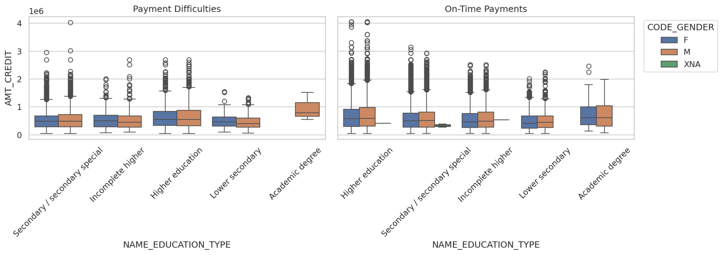
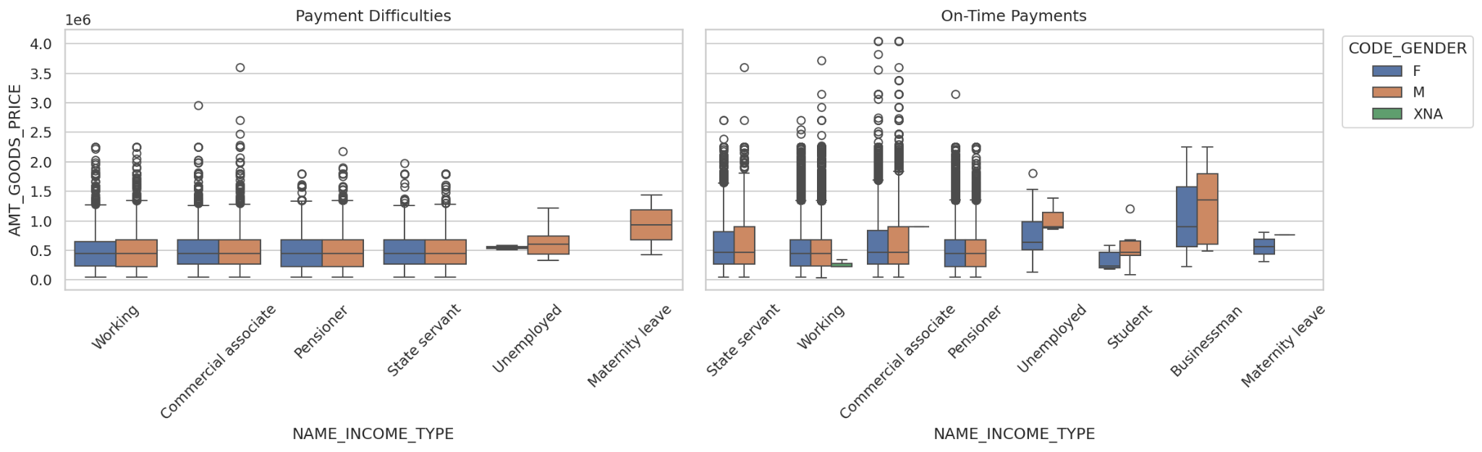
06 • Bivariate Analysis
Socioeconomic Factors vs Financial Magnitudes
Education vs. Credit Amount
Gender
Higher education levels are associated with larger typical credit amounts; gender differences are minor relative to education differences.
Income Overlap
Income Type vs. Goods Price
Income source differentiates financed goods price more than gender; business/commercial categories show higher typical goods price, while student/unemployed categories are lower.
Key Conclusion
Income type appears to explain more variation in financed goods price than gender differences.
Minor data-quality issue: Small number of unknown-gender (“XNA”) records.

Slide 9
08 • Business Implications
Actionable Recommendations
1
Risk Segmentation Signals
3
Feature Prioritization
Stability-related attributes (employment tenure, education level, age) provide stronger separation between repayment groups than raw financial magnitudes. These variables should be prioritized in early screening rules.
Relative metrics (e.g., loan-to-income ratio, tenure-income interactions) are likely more predictive than absolute values. Raw credit amounts showed limited discriminatory power.
Action: Implement education-based risk tiers and tenure thresholds
Action: Engineer ratio-based features for scoring models
2
Underwriting Alignment
4
Operational Considerations
Loan amounts appear income-aligned among reliable borrowers but not among defaulters. The near-zero correlations for defaulters suggest underwriting misalignment .
Segments with extreme percentages but very small sample sizes (e.g., Unemployed at 36-40% default rate, n=22) should not drive policy decisions. Count-dominant groups should be evaluated using rates, not raw volume.
Action: Enforce income-consistency checks and debt-to-income limits
Action: Use approval/default rates for count-dominant segments
Strategic Impact: Incorporating structural stability indicators and interaction-based measures can help lenders more effectively distinguish reliable applicants from high-risk ones, directly supporting the business objective of optimizing approval decisions .

Slide 10

Key Takeaways
Data-Driven Risk
Optimization
Stability Over Magnitude
Alignment Matters
Relative Metrics Win
Structural stability indicators (employment tenure, education, age) provide stronger risk separation than raw financial values.
Income-aligned loan sizing among repayers vs. misalignment among defaulters highlights the importance of underwriting consistency.
Loan-to-income ratios and interaction-based measures are more predictive than absolute loan amounts or income values.
Core Insight
Incorporating structural stability indicators and interaction-based measures enables lenders to more effectively distinguish reliable applicants from high-risk ones , directly supporting the optimization of approval decisions and minimizing both opportunity loss and credit risk.
Data Bootcamp Group 12
February 2026
Skye Xi • Jonathan Cain • Sab Rajesh Krishnan
Credit Risk EDA Report

